Slide 1
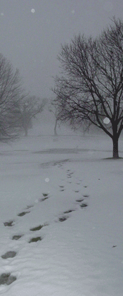
Stopping By Woods on a Snowy Evening
Robert Frost
1923

Slide 2
Whose woods these are I think I know. His house is in the village though;

Slide 3
My little horse must think it queer To stop without a farmhouse near

Slide 4
Between the woods and frozen lake The darkest evening of the year.

Slide 5
He gives his harness bells a shake To ask if there is some mistake.

Slide 6
The only other sound's the sweep Of easy wind and downy flake.

Slide 7
The woods are lovely, dark and deep. But I have promises to keep,

Slide 8
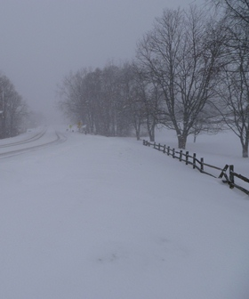
And miles to go before I sleep, And miles to go before I sleep.

Slide 9
Song of Solomon

Slide 10
For, Lo, the Winter is Past
Winter

Slide 11
The Rain is Over and Gone
Spring

Slide 12
Flowers Appear on the Earth
Flowers Appear

