Slide 1
Catalogue
Rosalie Moore

Slide 2
Catalogue
Cats sleep fat and walk thin

Slide 3
Catalogue
Cats, when they sleep, slump: When they walk, pull in-
And where the plump's been, there’s skin

Slide 4
Catalogue
Catalogue
Dog
Pluto
Goofy
Cat
Mouse
Mickey

Slide 5
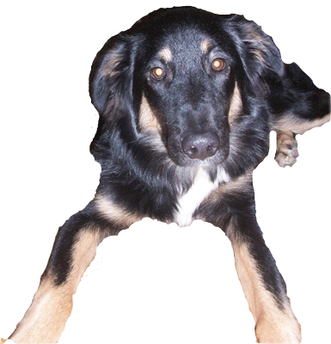
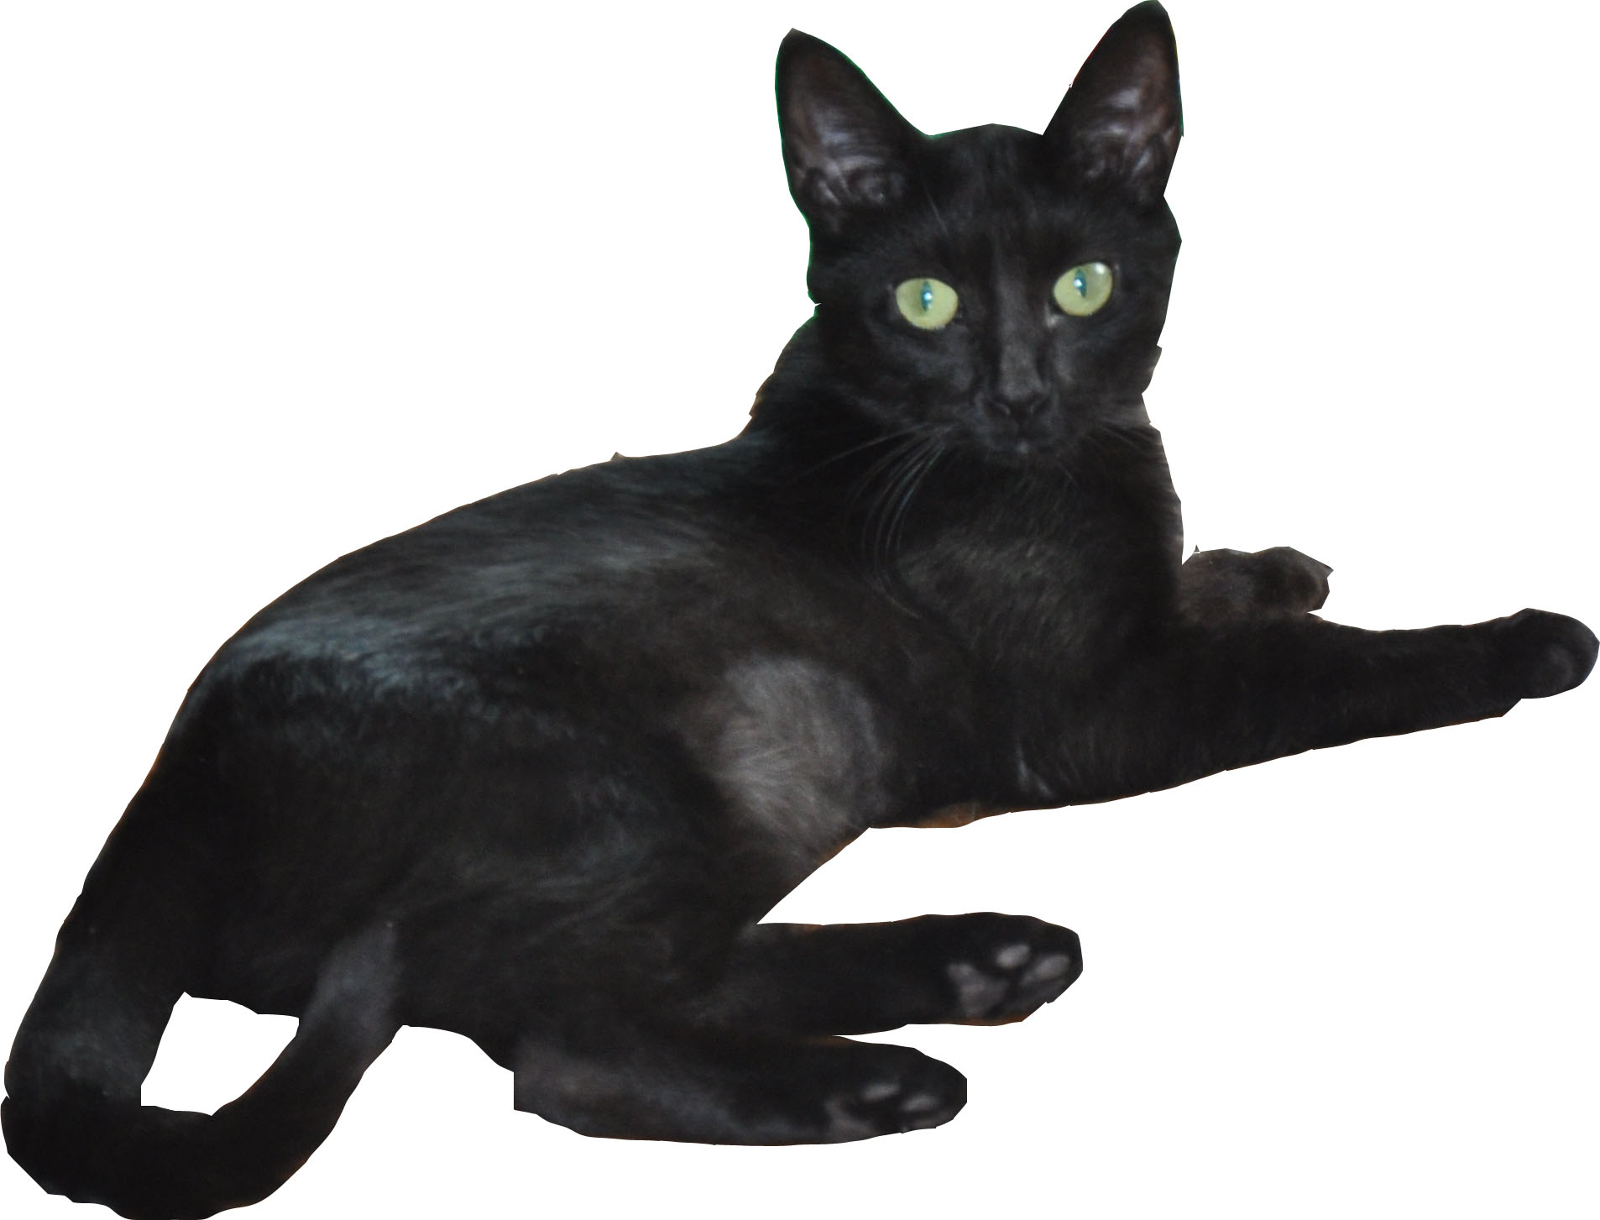
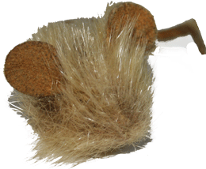
Catalogue
Catalogue
Dog
Pluto
Goofy
Cat
Mouse
Mickey
Catalogue
Dog
Cat
Mouse
Pluto
Mickey
Goofy

